Slide 1

2027 GO Bond Instructions
2027 General Obligation Bond Program
2027-2036 Decade Plan
Update class
Capital Implementation Program
Department of Municipal Development
Jennifer Turner, Director
Shawn Maden, CIP Official

Slide 2
Introductions
Shawn Maden
CIP Official SMaden@cabq.gov 505-768-3616
Josh Herbert
CIP Strategic Program Manager Josh@cabq.gov 505-768-3891
Vannessa Martinez
CIP Program Manager VaMartinez@cabq.gov 505-768-3856
Marlene Chavez
CIP Program Coordinator MarleneChavez@cabq.gov 505-768-4469

Slide 3
GO Resources
Page
cabq.gov/municipaldevelopment/programs/27goinfo

Slide 4
Reminders
The first priority of the City’s Capital Improvement Program is to rehabilitate, replace, and maintain capital assets in good condition
Justify projects using Criteria & Goals in the PRF and during the Staff Review Committee; be prepared to promote projects at the CIP Committee
Round all requests to the nearest $5,000
Complete the Operating & Maintenance (O&M) form, if applicable
CCIP expires after 7 years — review the 2025 program and ensure projects remain on the CCIP list
Stay diligent on state grant spending, reauthorizations, and avoiding reversion
  G-Grants: 6/30/26
  H-Grants: 6/30/27
  These are reimbursement deadlines
2026 J-Grants – 10% Obligation Requirement:
  Must obligate at least 10% within one year (binding contract or PO required; planning alone does not qualify)
  Must expend 85% within 3 years
Continue responding to questionnaire follow-up inquiries
Vehicles must comply with EI-34 and AI 4-3 (Reduced Emissions) whenever possible
New legislation takes effect in 2027 — see next slide for details

Slide 5
2026 HB 247
Only 1 reauthorization permitted
  Must be a minimum of 10% encumbered (approved Notice of Obligation)
    Technical scope change does not have to be encumbered, but will still only be 2 years
Only technical language changes allowed, cannot change purpose
  Change of location not permitted
  Addition of equip, acquire land, etc. is the intent
Must have 10% encumbered by Jan 1 of the reversion year, or grant is lost
  23-H grants and 25-J4XXX (Reauth) grants must meet this 10% by Jan. 1, 2027
    Recommend H grants get 5% encumbered right away
    GA’s currently require 10% encumbered within 1 year, 85% expended 6 months prior to expiration
      This is not new, but previously unenforced
NPOs large chunk of reauths
No appropriations or reauthorizations of >$100K unless on ICIP
  We are making an NPO ICIP # to address

Slide 6
2026 HB 247 – Impacts
Equip Grants only 2 years
  Majority of NPOs are equip
  APD Tech
  Fire Apparatus
When the grant is enacted is irrelevant
  Use Agreements
  Questionnaires
    Portal only opens every 6 months
Expect greater pressure to expend/obligate
CIP reports 1 year prior regarding 10% unobligated

Slide 7
Criteria Resolution
Section 8 – Departmental Funding Allocations
 | Approx % | Allocated | +20%
Streets | 20% | $33,750,000 | $40,500,000
Storm | 5% | $8,250,000 | $9,900,000
Parks & Recreation | 10% | $16,500,000 | $19,800,000
Public Safety | 12% | $19,000,000 | $22,800,000
ABQ Ride/Transit | 2% | $3,250,000 | $3,900,000
Housing, Health, & Homelessness | 7% | $11,500,000 | $13,800,000
Community Facilities | 27% | $44,625,000 | $54,104,400
Total | 83% | $136,875,000 | $164,804,400

Slide 8
Criteria Resolution
Section 8 – Mandates
 | Approx % | Allocated
Council-Neighborhood Set-Aside Program | 9.5% | $15,750,000
3% for Energy Conservation | 3% | $4,950,000
3% for Open Space Land Acquisition | 3% | $4,950,000
1.5% for Art in Municipal Places | 1.5% | $2,475,000
Total | 17% | $26,625,000
Please note that, in accordance with O-23-81, the Council-Neighborhood Set-Aside Program is scheduled to increase to $18M for the 2029 and subsequent GO Bond Cycles.

Slide 9
Allocation
Chart
Actual funding will be calculated based on the program % based on the Council Approved G.O. Bond Program.
In order to give policy makers a reasonable needs analysis, the required submission is greater than the available funding by about 20%
Council Set-Aside - $15.75M increasing to $18M next cycle

Slide 10
CIP Process
Upgrades
Power BI Dashboards
  Projects Dashboard
ProCore fully online
  Using for all Capital Projects
  Almost all Departments are running capital projects through ProCore
Next big step for ProCore
  Peoplesoft Integration
  Blue Sheets Automation
Continuously Improving – feedback is welcome
Pushing for increased funding, more discipline on rehab through FCAs

Slide 11
Facility Condition Assessments
& Asset Management
General Services Department
  Approximately 10% of City buildings have an FCA, does not apply to roads, parks, storm drainage, etc.
  Depts may have legacy asset management plans if GSD has none
FCAs
Kristin Gardner
Facilities Official ktgardner@cabq.gov 505-857-8087
Ronny Chavez
Senior Project Coordinator RRChavez@cabq.gov 505-857-8015
Energy Assessment
Saif Ismail
Energy Sustainability Division Mgr SIsmail@cabq.gov 505-768-5391

Slide 12
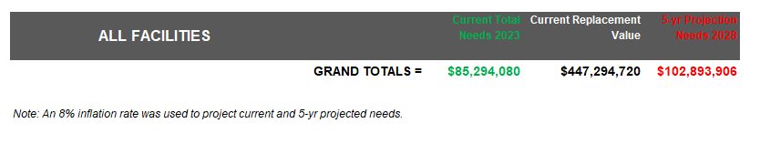
Deferred
Maintenance
Average ~8% base cost increase per year, not including general inflation
Roof patches become replacements, associated interior damage
Windows leak, causing rot, energy waste
Stucco breaks bypass waterproofing design
Potholes or safety risks cause injuries

Slide 13
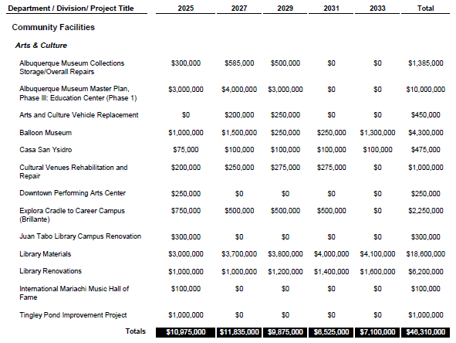
Decade
Plan
Still constrained for “actual” decade plan, but have separate small form for needs
Decade plan linked on resources page

Slide 14
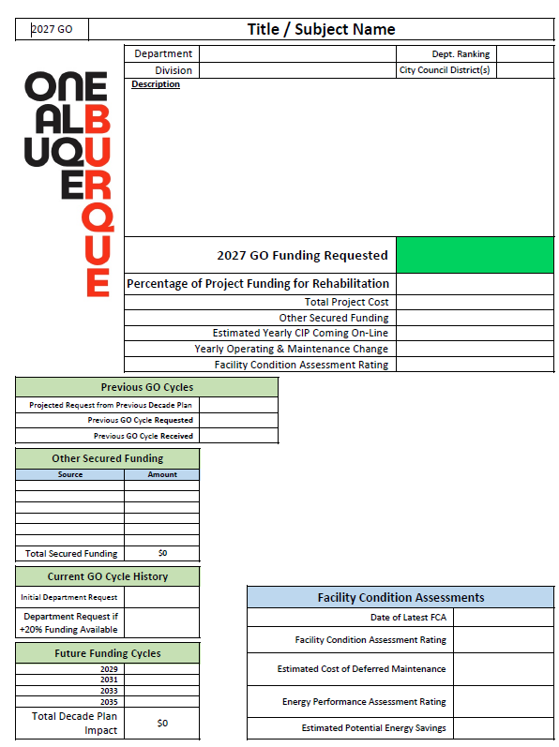
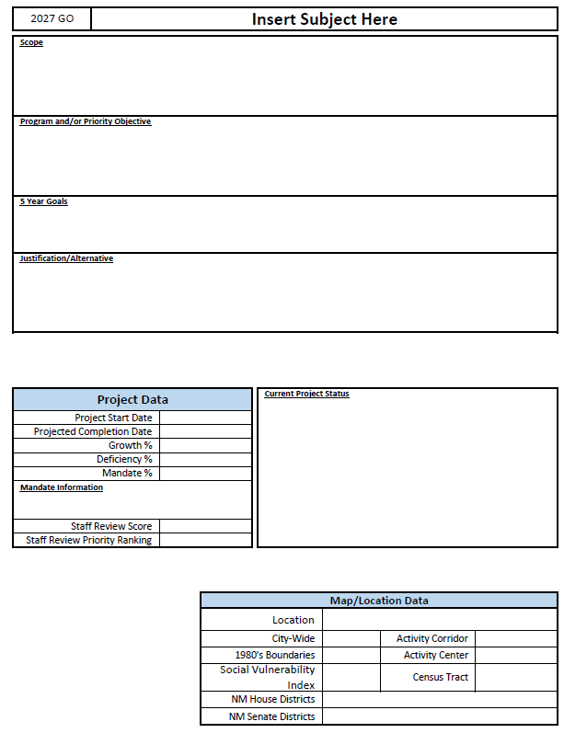
Project
Request
Form

Slide 15
https://login.procore.com/
Project Request
Form

Slide 16
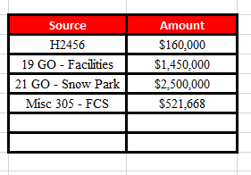
Existing
Fields
PRF Part 1 and 2 are still mandatory
  Same fields as 2025 GO Project Requests
  Other funding field requires applicant to fill out an excel sheet and copy/paste into filed
Rehab %
  Separated from other % numbers due to form requirements, total % of project still needs to =100%
Project Title is Subject
Estimated Completion Date is reflects as “Due Date” on the form

Slide 17
PRF Updates
Refined Parts 1 and 2 but retained data fields
Change in yearly CIP coming on-line – Estimate annual capital replacement needs created by this project (increase or decrease!) by looking at replacement value vs expected life
  Use: asset value ÷ useful life
  Include increases or decreases in long-term capital burden
  Do not include operating or maintenance costs (those belong in O&M)
Change in yearly Operating & Maintenance
  Use totals from the O&M Expense Analysis form
  Include:
    Staffing, utilities, recurring costs
    Any new operational needs from project growth
  If claiming cost savings, they must be shown in the O&M form
Part 3 and Part 4 clarified
  Part 3 is ONLY your sub-project list
    Added funding amount in the sub-project list in Part 3
  Part 4 adds data fields from the O&M form for reporting
    Part 4 is only for O&M Data
Added a separate form for future Decade Plan needs departments are not requesting for 2027

Slide 18
Decade Plan Needs
If submitting just for Decade Plan, only the basics are needed (Fill out if not requesting this cycle)
  Department
  Subject
  Description
  Department Ranking
  Rehab %
  “Planned” requests for 2029 – 2035 (Leave Amount requested for 2027 blank)
  Total Project Cost
  Ideally when project would have begun (year)
  Ramifications for delaying implementation
  Checkboxes for (Pick 1)
    Deferred Maintenance - Current need but deferred due to lack of funds
    Planned Growth
    Service Deficiency Correction

Slide 19
GO Resources
Page
cabq.gov/municipaldevelopment/programs/27goinfo

Slide 20
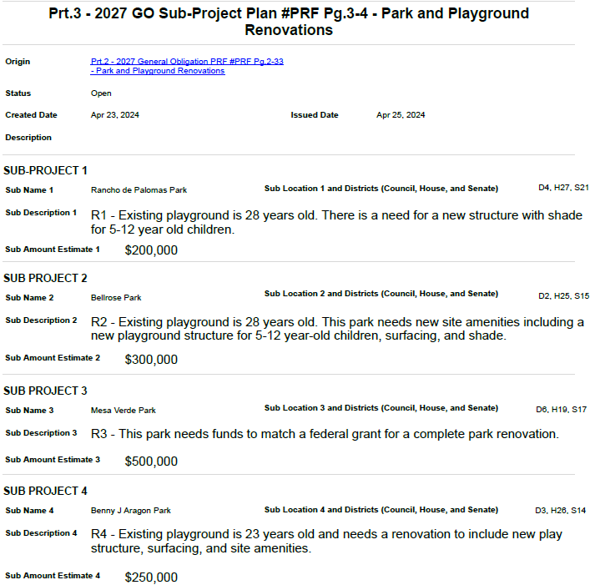
Sub-Project
Form

Slide 21
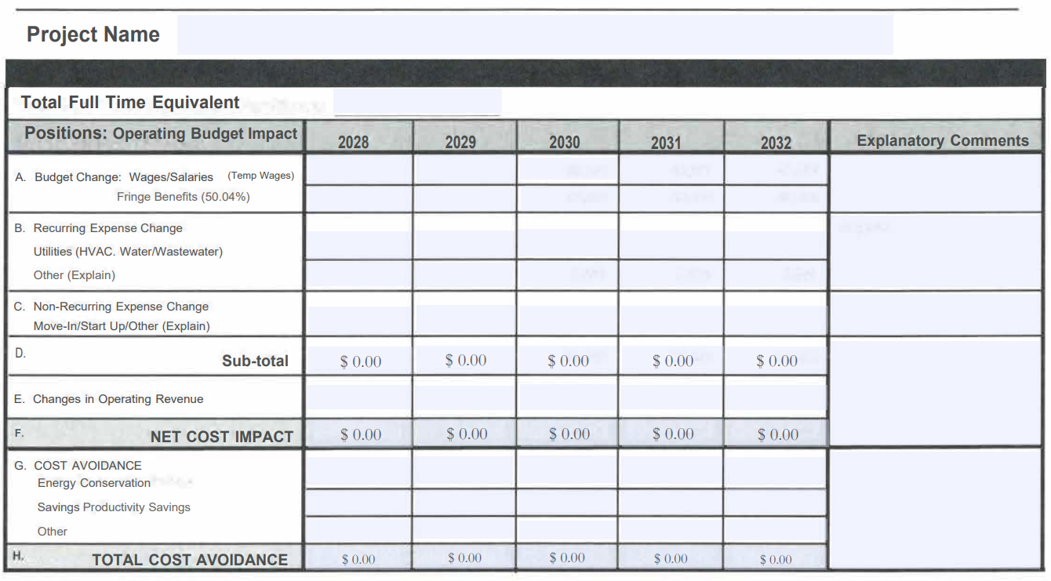
Operations & Maintenance

Slide 22
https://login.procore.com/
2027 General Obligation Bond Program
Project Request Forms

Slide 23
Important Dates
May 29, 3pm – PRFs Due
July 7 - 9, 1-5 PM – Staff Review Committee
  Presentations to evaluate against scoring criteria, no funding decided
August 11 - 13, 1-5 PM – Capital Implementation Program Committee
  Directors present to Chief Officers to determine funding
November 12, 8:40 AM-Noon – Environmental Planning Commission
  CIP presents, be prepared for questions
1st Council meeting in January – Council Review
  FGO, COW, Full Council – CIP presents, be prepared for questions, COW requires written

Slide 24
PRF Deadline
3pm Thursday May 29th, 2026
Thank you for your time!
Capital Implementation Program
Department of Municipal Development
Jennifer Turner, Director
Shawn Maden, CIP Official

